Slide 1
STA 545/EAS 506
Statistical Data Mining I
Application Project on Adult Income Dataset
Group Number: 2
Madhuri Vadyala (UBID – 50442120)
Srividya Amireddy (UBID – 50469095)
Anudeep Balagam (UBID – 50442091)

Slide 2
Content:
Initial Visualization
Pairwise Correlation
Supervised Learning Methods for Classification
Comparison of Performance for each Learning Method via Cross Validation
Understanding Predictor Contributors for each Learning Method
Understanding Estimation Stability via bootstrap

Slide 3
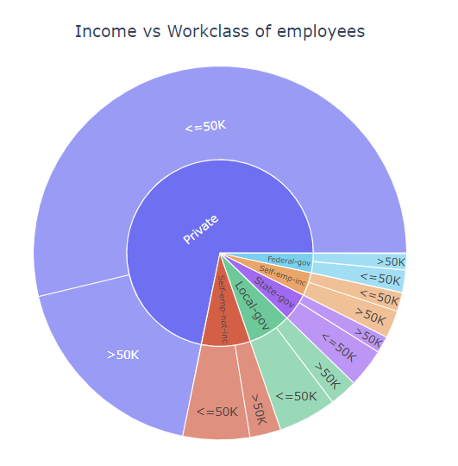
1. Initial Visualization:
Pie Chart of Income vs Workclass:
From the chart it is clear that there are more number of people working in private sector. Also, there are people working for less than $50k in the private sector.
We can also see that there are more number of people who are earning more than $50k only in the private sector.
There are less number of people working in Federal-gov and there salaries are almost equally split between less than $50k and greater than $50k.

Slide 4
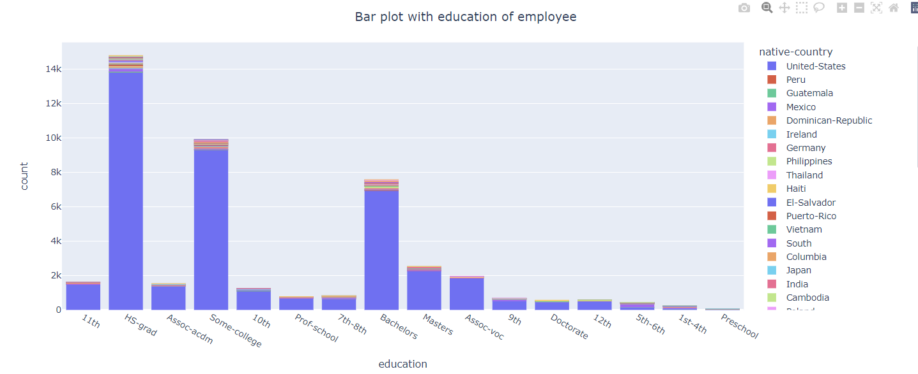
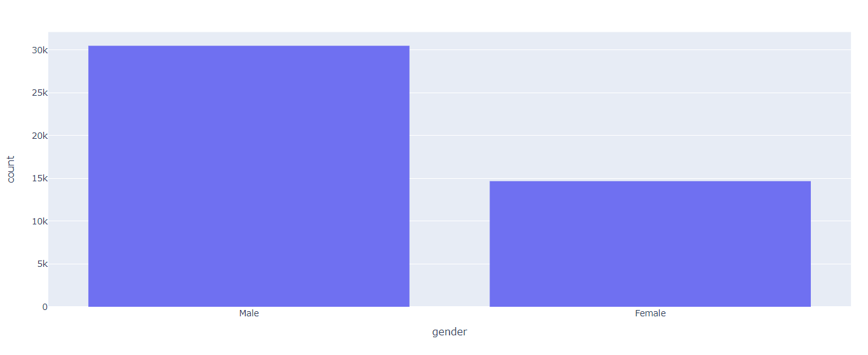
Bar Plot: Education
In this bar plot the color represents the feature ‘native-country’. From the plot it is clear that more number of people no matter what their education level is belong to United-States.
Bar Plot: Gender
From this plot it is clear that there are more number of Male employees than Female employees

Slide 5
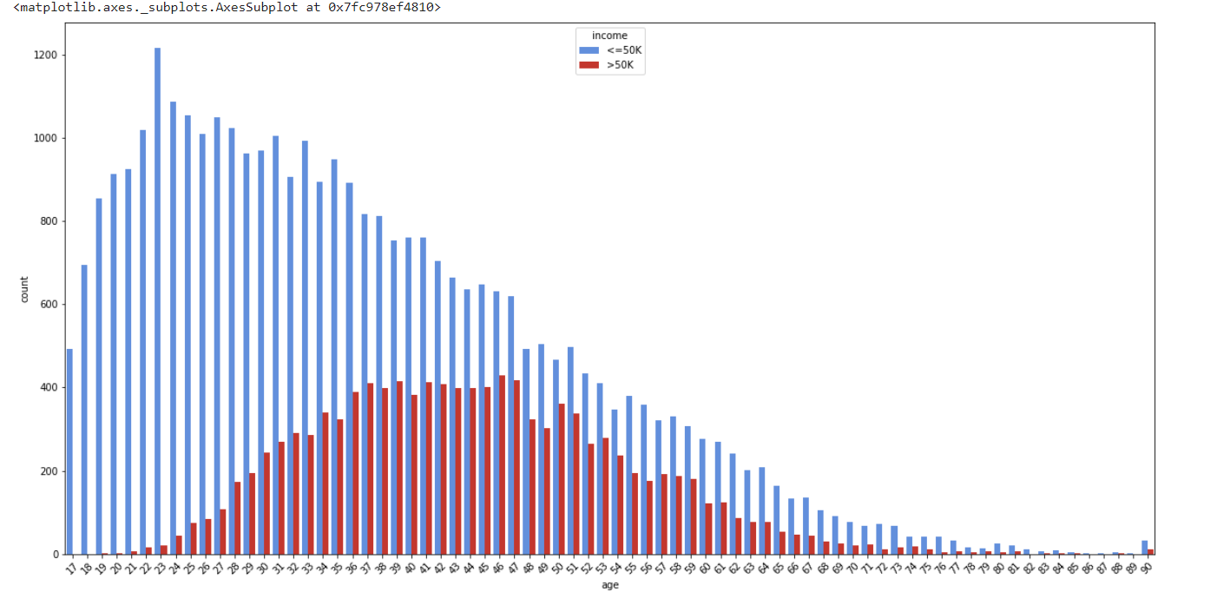
Count Plot: Age vs Income
This is very interesting plot. As age grows, there are more people earning more than 50,000$, so we can say that, generally, income is correllated to age.

Slide 6
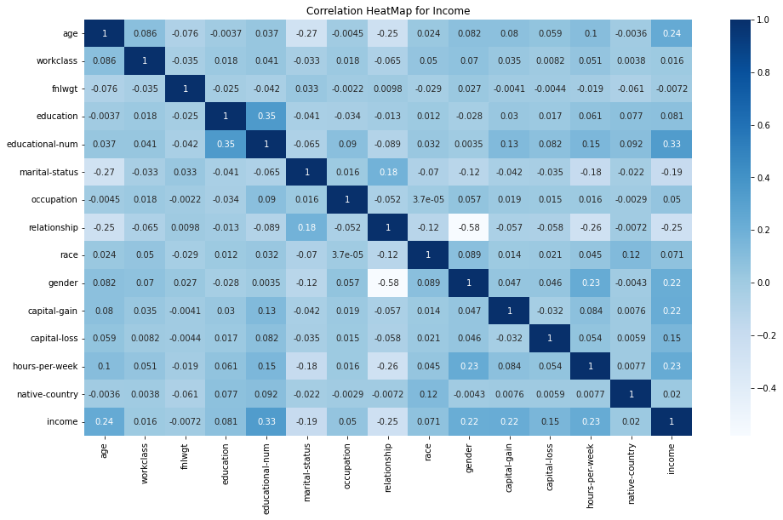
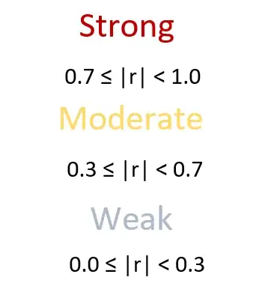
2. Pairwise Correlation of the Data:

Slide 7
3. Supervised Learning Methods for Classification:
Logistic Regression
Naive Bayes
K – Nearest Neighbor
Support Vector Classifier
Decision Tree
Random Forest

Slide 8

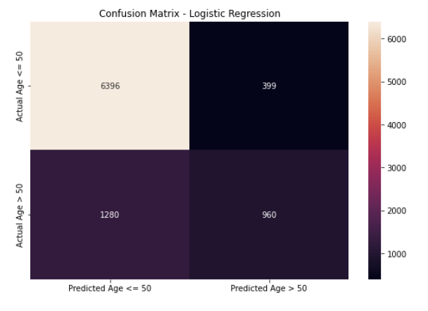
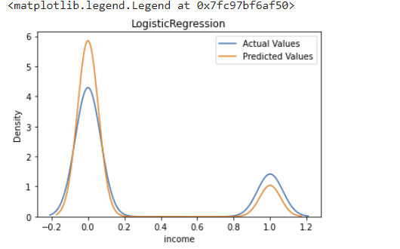
Logistic Regression:
This classification type adopts minimal training data. It predicts the probability of Y being associated with the X input variable.
Accuracy = 81.4%.

Slide 9

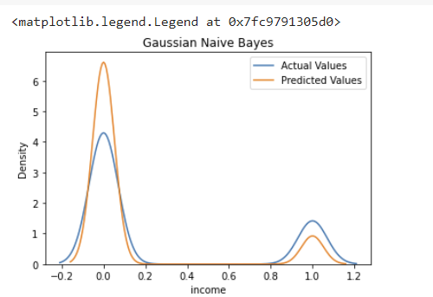
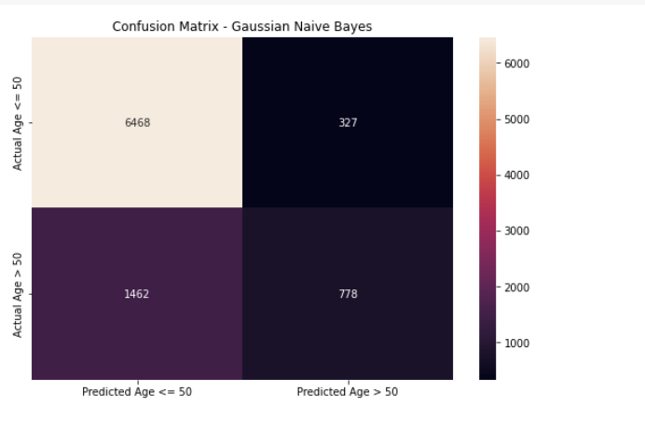
Naïve Bayes:
It is based on the Bayes theorem, which explains how the likelihood of an event is assessed using information about potential confounding factors in the past.
Accuracy = 79.61%.

Slide 10

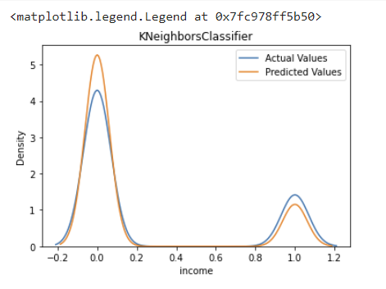
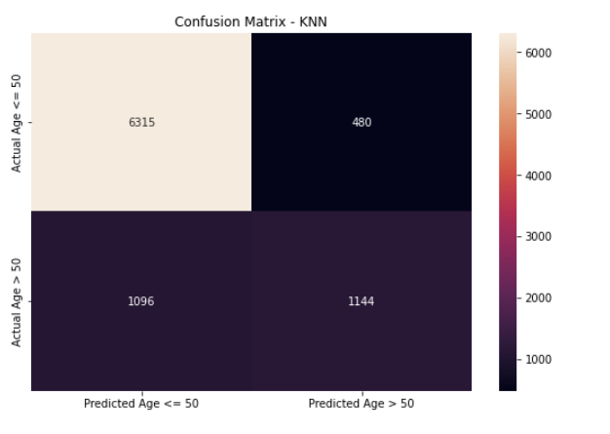
K – Nearest Neighbor:
The K closest neighbors to a given observation site are identified by this classification type. The target variable with the highest ratio is then predicted after evaluating the proportions of each type of target variable using K points.
Accuracy = 82.55%.

Slide 11

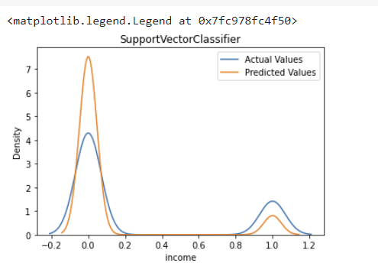
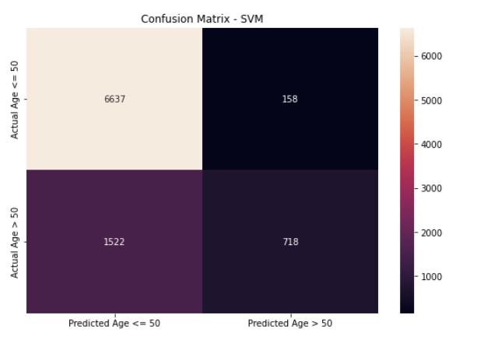
Support Vector Classifier:
Uses a subset of training points in the decision function (called support vectors), so it is also memory efficient. This technique is made feasible by using kernels, which are specialized functions, to expand the space occupied by feature variables. Effective for high dimensional spaces.
Accuracy = 81.40%.

Slide 12


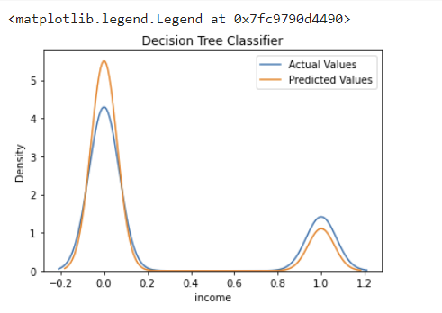
Decision Tree:
Based on specific feature variables, Decision tree separates a dataset into segments. The mean or mode of the feature variable in question, if it happens to be numerical, serves as the divisions' threshold values.
Accuracy = 85.20%.

Slide 13

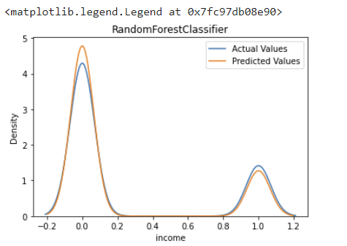
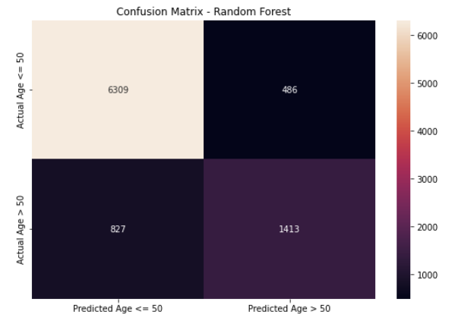
Random Forest:
Random forest processes many decision trees, each one predicting a value for target variable probability. We then arrive at the final output by averaging the probabilities.
Accuracy = 85.46%.

Slide 14
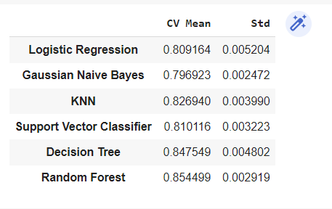
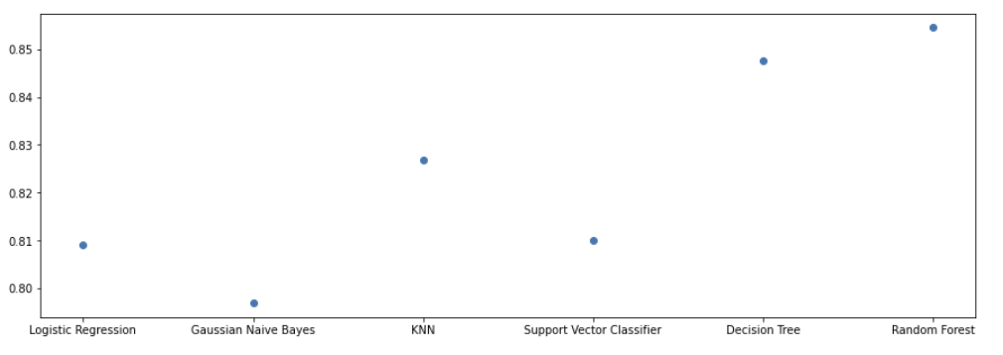
Comparison of Performance for each Learning Method via Cross Validation:
Cross Validation is performed on all the six models. From the results we can see that Random Forest and Decision Tree have almost similar performance.

Slide 15
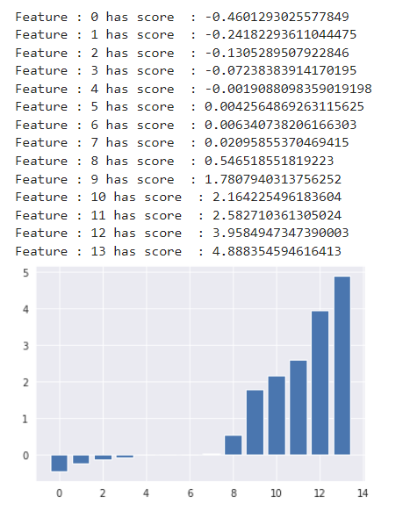
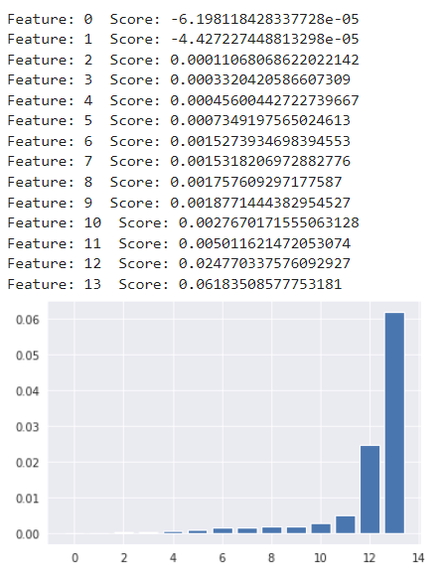
Understanding Predictor Contributors:
Logistic Regression:
Naive Bayes:
From the above graph it is clear that features 10,11,12,13 have high predictor contribution for Logistic Regression.
From the above graph it is clear that features 12,13 have high predictor contribution for Naïve Bayes.

Slide 16
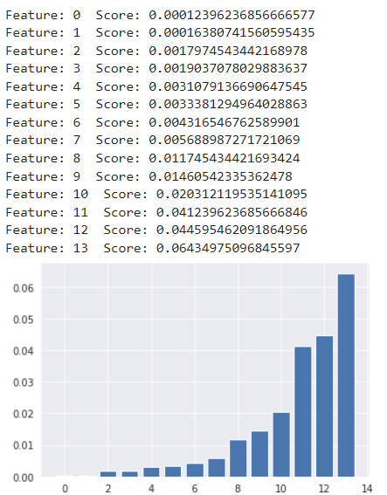
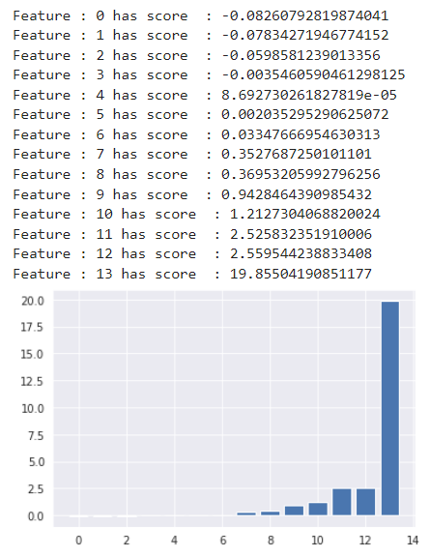
K – Nearest Neighbor:
Support Vector Classifier:
From the above graph it is clear that feature 13 have high predictor contribution for SVC.
From the above graph it is clear that features 11,12,13 have high predictor contribution for KNN.

Slide 17
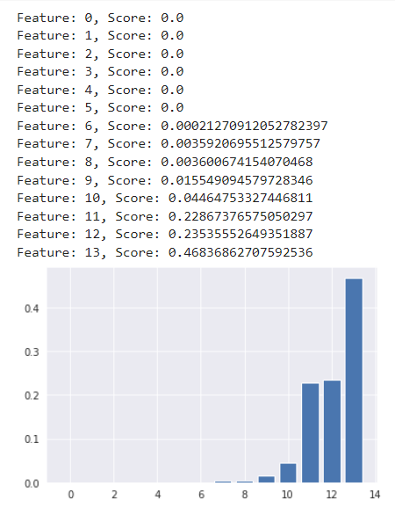
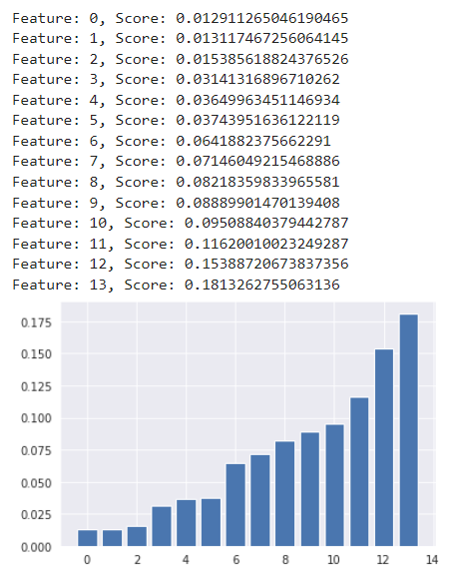
Decision Tree:
Random Forest:
From the above graph it is clear that features 13 have high predictor contribution for Decision Tree.
From the above graph it is clear that features 11,12,13 have high predictor contribution for Random Forest.

Slide 18
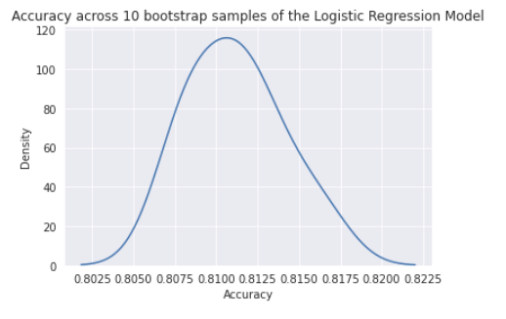
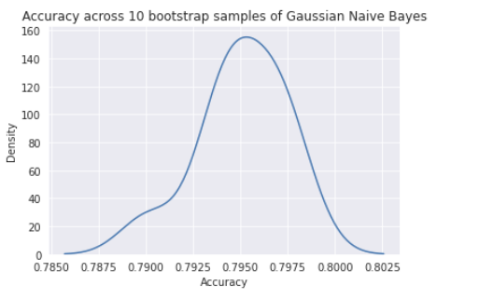
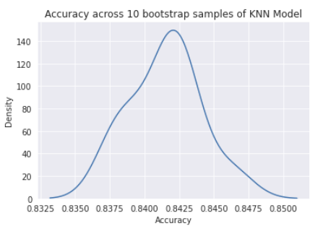
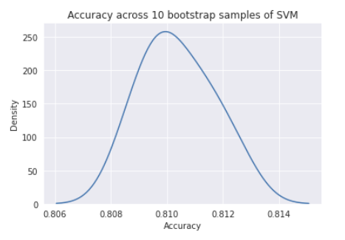
Understanding Estimation Stability via bootstrap:

Slide 19
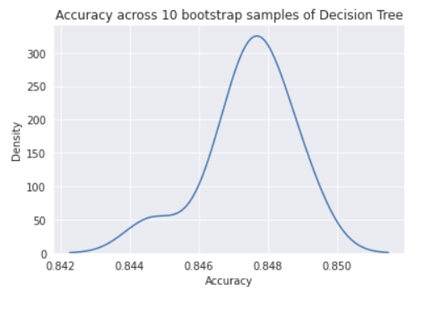
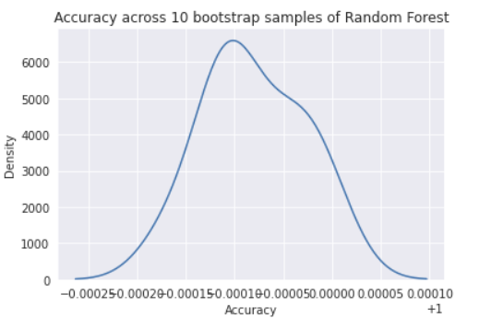
From the above graphs it is clear that, Random Forest model has the best result of all the 6 models we applied as the accuracy ranges from 99.8% to 99.9%

Slide 20
Thank you

